Slide 1
Coordinating roadworks in Derbyshire

Slide 2
Setting the scene
DCC has an obligation to fulfil its Network Management Duty (NMD) to do all that is reasonably practicable to manage its road network effectively with a view to keeping traffic moving
Pretty much everything you need for the 21st Century is in the Highway:
Gas.
Water (Clean and foul).
Electricity.
Telephone and broadband.
Utilities need to be repaired, replaced, or laid for the first time.
The utilities have long term plans to improve the asset and are using innovative technology to do so & to save time.
Cadent has to replace all iron pipework within 30m of all properties by 2032.
All new developments have to be connected up to utility networks.

Slide 3
Volume v Time
There are over 25,000 roadworks a year in Derbyshire (not necessarily involving an excavation).
Approximately 6 for every mile of network,
or 1 for every 300yds
Average duration of each works is 4 days
We have finite time and highway space to accommodate these works
1 out of every 5 applications for works is either cancelled, revoked or refused (there are over 31,600 applications)

Slide 4
Roadworks in Derbyshire in 2025-26
 | Other TM | Road Closure | Refused/Revoked/Cancelled | Total Applications
Immediate Emergency | 688 | 81 | 21 | 790
Immediate Urgent | 5216 | 817 | 154 | 6187
Major | 1384 | 1007 | 396 | 2787
Major (PAA) | 204 | 410 | 648 | 1262
Minor | 13661 | 37 | 4937 | 18635
Standard | 1581 | 38 | 383 | 2002
TOTALS | 22734 | 2390 | 6539 | 31663

Slide 5
Roadworks in Repton/Willington in 2025-26
 | Other TM | Road Closure | Refused/Revoked/Cancelled | Total Applications
Immediate Emergency | 8 | 5 | 0 | 13
Immediate Urgent | 30 | 6 | 3 | 39
Major | 24 | 15 | 6 | 45
Major (PAA) | 0 | 1 | 2 | 3
Minor | 116 | 0 | 34 | 150
Standard | 20 | 1 | 4 | 25
TOTALS | 198 | 28 | 49 | 275

Slide 6
Statutory Undertakers
NRSWA places a duty on undertakers to use their best endeavours, with regard to the execution of street works, to co-operate with the highway authority and one another.
However, the utility companies have statutory obligations to provide a supply or service:
Monitored by their regulator OFWAT (water industry), and OFGEM (gas and electricity industries
This will include restoring supply
ensuring new customers are connected within certain time frames.
OFCOM (regulator of telecommunications) places a universal service obligation on BT across the UK to meet all reasonable requests for service
Under legislation customers may be entitled to compensation if a company fails to meet these guaranteed standards of performance.
The operators of a gas network also have obligations under Regulations enforced by the Health and Safety Executive. These require operators of gas networks to carry out certain works within a specific time or to replace certain types of apparatus within a specified period.
Currently, the gas industry has a programme to replace all iron mains within 30 metres of properties, over 30 years, from 2001, with highest priority given to that apparatus at greatest risk, based on an agreed safety case to assess priorities.
The priorities may change to reflect an escalation of risk based on either new information about specific types of pipes or apparatus, or as result of incidents involving a specific pipe.

Slide 7
Balance
So, DCC’s NMD duties must be balanced against the statutory obligations of statutory undertakers. Statutory undertakers, or those in possession of a street works licence, have a legal right to carry out street works.
Both highway authorities and statutory undertakers operate under other statutes which impose additional obligations that impact on those obligations under NRSWA - for street authorities to co-ordinate all works, and for undertakers to co-operate.
Local authorities should act reasonably at all times and have duties imposed under a number of Acts.

Slide 8
Key Regulators, Acts and Codes
Water Industry Act 1991.
Gas Act 1986.
Electricity Act 1989.
Communications Act 2003.
Traffic Management Act 2004 – Part 2 Network Management Duty (Permit scheme and Traffic Manager).
New Roads and Streetworks Act 1991 (NRSWA).
Code of Practice for the Co-ordination of Street Works and Works for Road Purposes and Related Matters HAUC(England) Edition

Slide 9
NRSWA and CoP Key Points:
The power of highway authorities to give directions as to the timing of street works
The power of highway authorities to give directions as to the placing of apparatus
The duty of street authorities to co-ordinate works
The duty of undertakers to co-operate with street authorities and with other undertakers.

Slide 10
Timing of street works
Timing is subject to four constraints:
it cannot affect the right of an undertaker to execute emergency works
it can be used only where proposed street works are likely to cause serious traffic disruption that would be avoided or reduced if the works were carried out at other specific times
it can be used only where subsisting street works are causing, or are likely to cause, serious traffic disruption that would be avoided or reduced if the works were carried out at other specific times;
and a direction requiring street works to be executed out of normal hours should not be issued if it would cause the undertaker to breach noise abatement or prevention legislation.

Slide 11
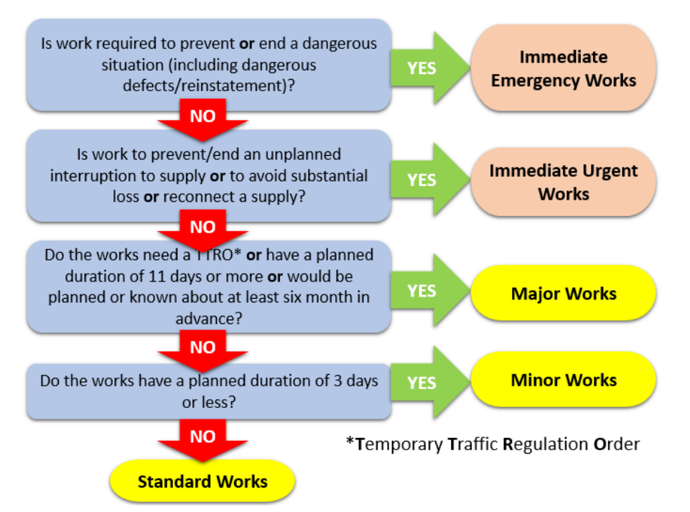
Types of work

Slide 12
Some Case studies
Bamford: Cadent Gas wanted to close the road for 5 weeks cutting the village and A57 (Snake Pass) off from the rest of Derbyshire.
Long Eaton: National Grid Electricity Distribution (NGED) wanted to lay a 33KV cable between East Midlands Airport and Toton through the middle of the town.
Chapel en le Frith: Severn Trent wanted to lay a reserve main through the centre of the town.
Baslow: Severn Trent wanted to lay a pipe in the A619 Nether End but eventually laid a pipe through Chatsworth Land and then under the river, and shorter works on the highway.
Grindleford: Severn Trent pipeline wanted 42-week road closure amended to traffic lights and a 3-week closure in the school holidays.
Willington Power Station access needed for abnormal loads; worked with Network Rail to look at weightbearing of their bridges.
B6540 in Long Eaton from North West Leicestershire; Planning permission given to build new warehouses that will require main road over the only river crossing between Nottingham and Derby to be closed for 3-4 months. No thought given to how people get into and through Long Eaton, or that haulage company is on wrong side of closure and stuck by weight limit into Long Eaton

Slide 13



Utility and Local Authority liaison

Slide 14
Utility and Local Authority liaison
Meetings for the above bodies are held at national, regional, and local level.
DCC and Derby City Council hold a joint quarterly coordination meeting for all Utilities and the Highway Authorities’ workers. This meeting also involves reps from surrounding LHAs and National Highways.
Meet quarterly with the major utilities on an individual basis looking at best practice and solving problems at managerial level.
DCC host mini coordination meetings on major schemes.

Slide 15
What we consider when coordinating works
Roads needed
Diversions
Timing of works
Time Constraints for the works
Other works in area and whether any collaboration can take place.
The type of work
Other options including laying apparatus elsewhere i.e. away from the highway, or in different roads
Traffic management required (this depends on many factors including speed of the road, road width and safety)
Comms
Impact on and mitigation for:
school buses, school exams, school holidays
businesses
travelling public
public transport
public bin collections
events nearby
haulage routes
other works in area and whether any collaboration can take place.
Emergency health services
Access to other health services
Access to businesses, residential properties and schools etc.

Slide 16
Diversions
These follow like for like road
Generally, by classification
i.e. close an A-Road, the diversion should follow A-Roads
Or in worse case by highway inspection category (only really on country lanes)
Create one for all types of traffic
need to avoid low structures
Weight restricted structures
Need cooperation from neighbouring authorities if we need access to their part of the network
Satnav will not take you on the diversion but on the:
Quickest
Most fuel efficient
Shortest route
Irrespective of network classification
Some can be set to keep you on A and B Roads
What may appear to save you 10 mins soon becomes 30mins slower as everyone starts going the same way

Slide 17
Permit conditions for Road Space
1a & 1b: Duration.
2a: Limit the days and times of day.
2b: Working hours.
3: Activities ancillary to those permitted - supplementary information.
4a: Removal of surplus material/plant.
4b: Storage of surplus materials/plant.
5a: Width and/or length of road space that can be occupied.
6a: Road space to be available to traffic/pedestrians at certain times of day.
7a: Road closed to traffic.
8a: Traffic management request.
8b: Manual control of traffic management.
9a: Changes to traffic management arrangements.
9b: Traffic management arrangements to be in place.
9c: Signal removal from operation when no longer required.
9d: Changes to traffic management arrangements.
10a: Employment of appropriate methodology.
11a: Display of permit number.
11b: Publicity for proposed works.
12a: Limit timing of certain events.
13: Exceptional circumstance.

Slide 18
Fines and penalties
Working without a permit - £1000 (£600 for early payment).
Not complying with Conditions of Permit - £240 (£160 for early payment).
Overrunning allocated permit time – up to £5000 per day depending on type of road.
Leaving up to 5 items of apparatus on street after works £100 first day, and then Up to £5000 per day depending on type of road.
Leaving more than 5 items - Up to £5000 per day depending on type of road.

Slide 19
What are we trying to achieve with Streetworks undertakers?
Better long term coordination with all utilities.
Seeking best practice for short term road closures.
Asking DfT and regulators to consider impact of streetworks on traffic.
Get DfT (or Central Government) to legislate that Developments get one go at the Highway for all their infrastructure connections.
Review Immediate notifications: Not everything is an emergency.
Early notification of the above (they do have to plan their responses so can tell us earlier)
Correct traffic management for each site, and better use of manual control or intelligent lights.
Better accuracy in timescales; off as soon as possible.
Continuing to identify times/days/months where roadworks could/should be avoided.
Understanding utility processes so we can improve their understanding of the impact of their works on traffic

Slide 20
The Key Issues
Utilities, and other roadworks/streetworks undertakers have no KPIs to think about traffic management.
DCC cannot monitor every streetwork and roadwork 24/7. We have 6 Inspectors for the whole County. We are looking at ways to improve this.
DCC can only fine undertakers who we catch, or who are reported by the Public; need photographic evidence.
DCC expects all statutory undertakers to behave.
Pressure to increase housing stock. All the infrastructure these developments need are in the Highway.
The Heineken Moment. This has to be the aspiration. So how does this happen…
Not everyone one needs to go into the same space at the same time
And if they do, they cannot go in the same space at the same time as there is no space

Slide 21
Roadwork notifications
County Councillors and Parish Councils should get notice of upcoming road closures via email direct from our service.
As members of the public to see all roadworks in your area or across the County see One Network/CausewayOne You can set up an account on CausewayOne to receive daily, weekly, monthly emails on road works about to start in your personally defined area of interest.
CausewayOne (One.Network) how to set up an account How to create a public account | one.network
CausewayOne (One.Network) email alerts How to set up email alerts on Causeway one.network

Slide 22
Reporting problems at roadworks
Please contact the utility company first.
We need more members of the public to do this, so that the utilities are not just being harangued by the usual highways officers!
Ring Call Derbyshire who will pass it through to the team.
Report on Line at Traffic signals and crossings - Location - Section 1 - Self

Slide 23
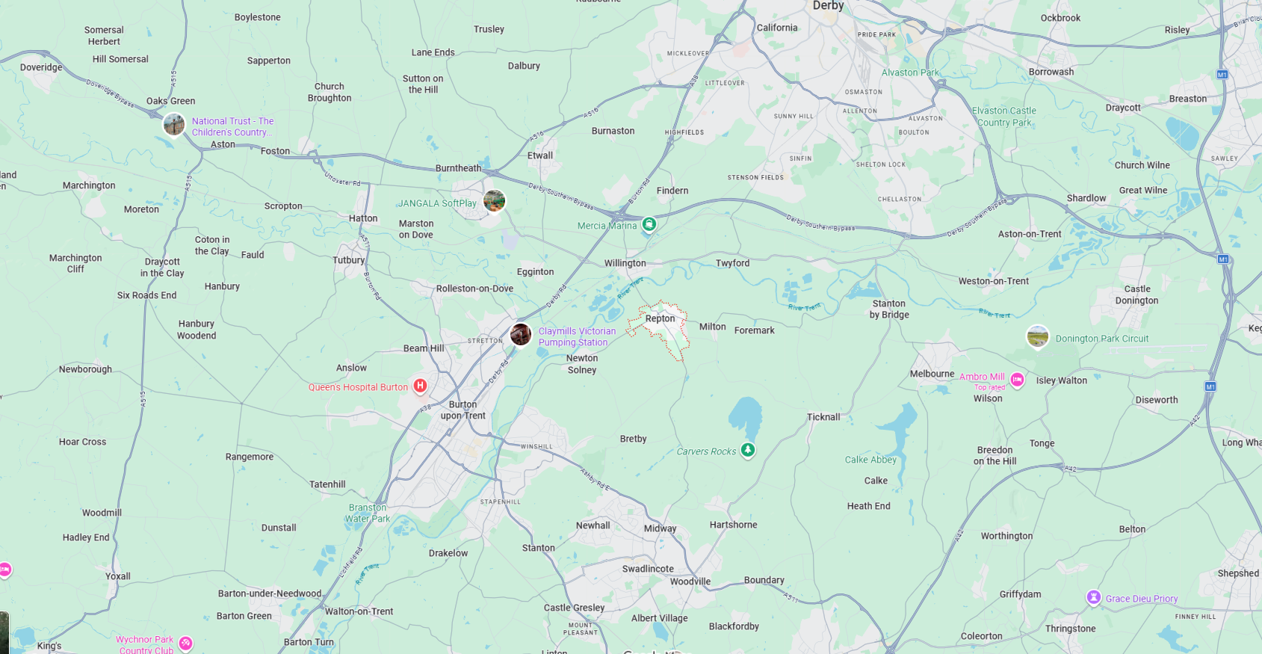

Slide 24
Last Two Years
National Grid Telecomms Cable from Power Station through Willington/Repton towards Hartshorne
Had to come over Willington bridge
Were going to go down Repton High Street but we modified the plan to Milton Road etc
Gas works renewal in Willington and Repton
DCC Highways Surface Dressing
Asked for this to be done early mornings for the dressing
Overnight for associated works

Slide 25
The Current Situation
National Grid Reinforcement Scheme Newton Solney
Road Closed two weeks - Easter Hols to 13th April
McDonalds Castle Way/A38
20th April 10 days one way suspension
To go A38 Southbound need to go Willington/A50/A38
Willington Bridge Repair
When?
Road Closed?
Diversion?
Duration?
Works we have delayed:
Completion of Gas main renewal in Repton due to disruption over last two years
They will need to close High Street for 12 weeks at some stage (Summer 2027?, subject to Cadent priority)
Until then they will continue to have emergency works for gas leaks
Hatton Gas works whilst Willington Bridge is repaired this summer hopefully
Works at Swarkestone will be paused from end of April to account for exam period and summer holidays to allow for the Willington Bridge
Collaboration with National Highways on A38
And then there are things we do no know about – Emergencies?

Slide 26
Questions?

